Slide 1

Evidence to action:
Impact of investing in research co-design
24 August 2026

Slide 2
Acknowledgement of Country
The NDRP acknowledges the traditional custodians of Country throughout Australia. The peoples on whose land we live and work, have lived on and cared for Country for thousands of generations, and this land has never been ceded. We pay our respects to them and their cultures, and to Elders past and present.

Slide 3
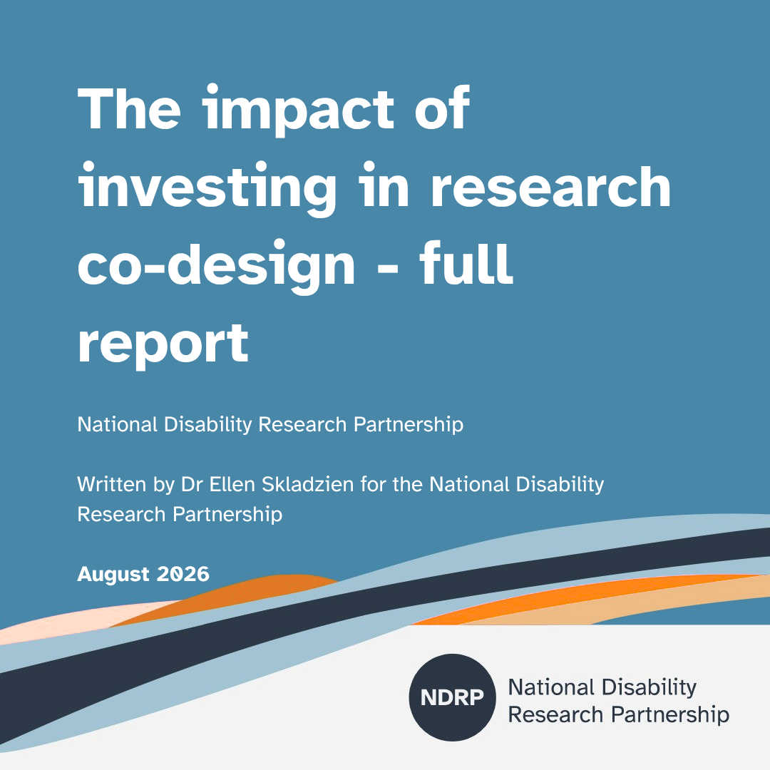
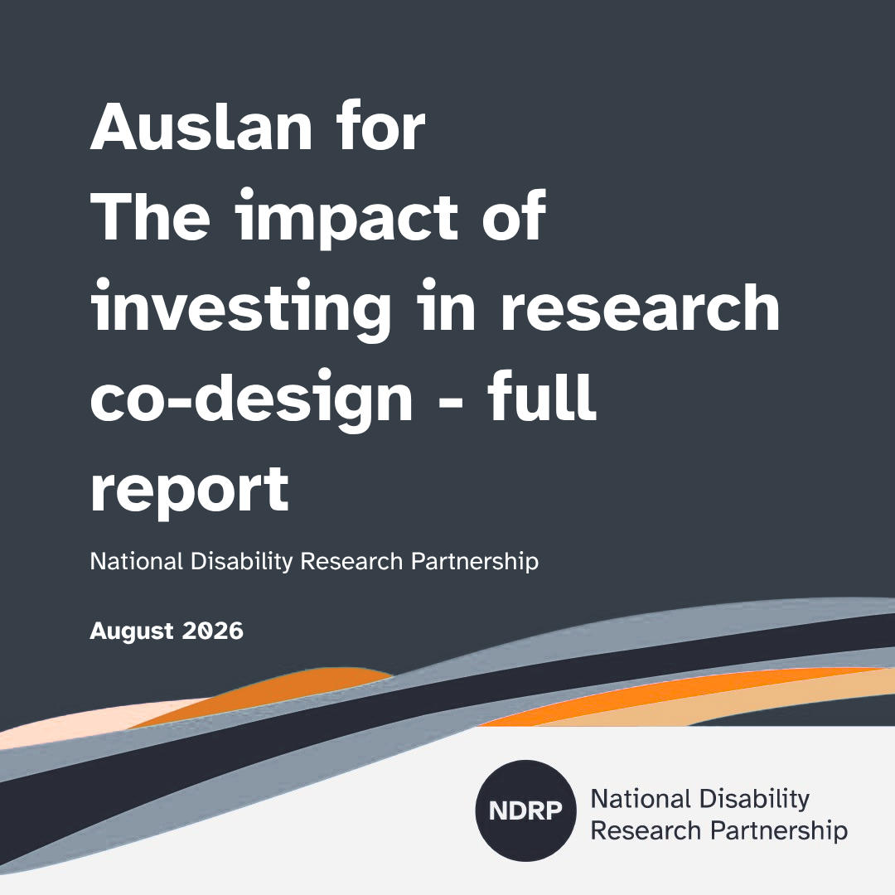

The impact of investing in research co-design
written for NDRP by Dr Ellen Skladzien
Notes:
Slide 4
Title: Senator the Hon Jenny McAllister, Minister for the National Disability Insurance Scheme

Slide 4
A different approach to disability research
Common approach
Research design→ Research proposal→ Funding → Codesign
NDRP Seed Funding
Codesign → Research design→ Research proposal→ Future research
NDRP invested in codesign before the research questions and methods were decided.

Slide 5
Codesign changed the research
“When people with lived experience had real authority, decisions changed in meaningful ways” Safe in my own skin
Research questions changed
Methods changed
The definition of safety changed

Slide 6
Codesign strengthened capability
“Being part of this research team is the first time I've felt like I had a voice”
Psychological safety for children with ‘behaviours of concern’
People with disability
Skills, confidence, research experience
Partnerships
Relationships, trust, new ways of working

Slide 7
Codesign needs the right conditions
“Co-designing research, particularly on sensitive and complex topics, takes time, trust, resources and really good partnerships with diverse stakeholders.”
Hidden in Plain Sight
Leadership
Disability leadership
Power sharing
Safety
Trust
Cultural safety
Psychosocial safety
Resources
Accessibility
Time
Investment

Slide 8
Structural Challenges
Funding
Codesign often starts too late.
Institutional systems
Can create barriers to disability-led research
Employment
Practical barriers for researchers with disability
Data and Evidence
Important information is missing or evidence is not acted on.

Slide 9
Lessons from the Seed Funding Round
Fund codesign early
2. Create the right conditions
3. Invest in capability and partnerships
4. Change the systems that create barriers

Slide 10
Get in touch
Email: Ellen@skladzienconsulting.com.au

Slide 11

From co-design to action
Notes:
Slide 4
Title: Senator the Hon Jenny McAllister, Minister for the National Disability Insurance Scheme

Slide 12
Using research to influence systems change
Existing evidence
Recommendations made
Implementation gap
Accountability gap
Opportunity for research

Slide 13
What decision makers often look for in research
Research that helps decision makers:
Understand what is happening and why
Address real policy and service challenges
Connect with current reforms, reviews and policy priorities
Explain what the findings mean for policy or practice
Research that considers the policy system:
Different levels of government and responsibilities
Where national, state and territory collaboration is needed
How research can inform future decisions or reforms
Research that supports action:
Identifies evidence gaps
Explains implementation challenges
Considers costs, benefits and feasibility

Slide 14
What to listen for
What changed because people with disability were involved before the research began?
What conditions made meaningful co-design possible?
What barriers in the wider research or funding system did teams encounter?
What will last beyond the funded project - whether that is a partnership, capability, a clearer research direction or an opportunity for action?

Slide 15
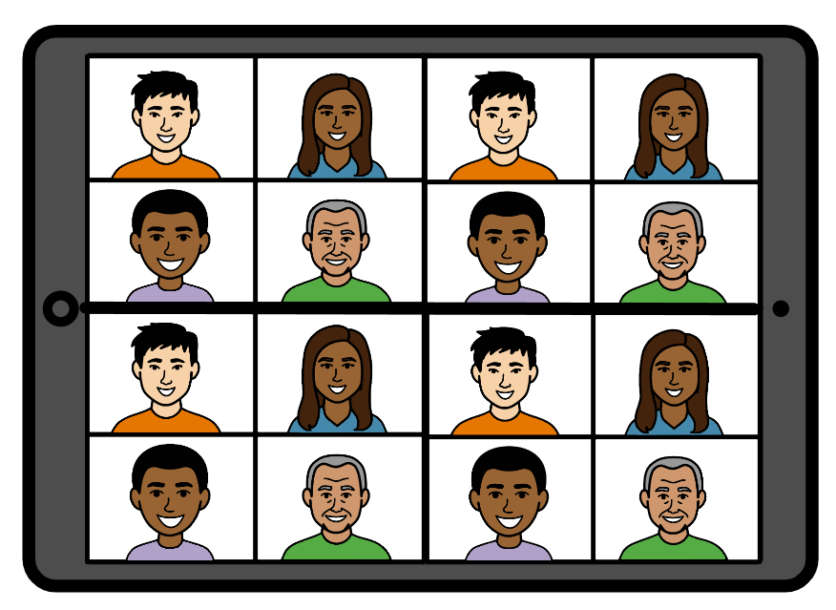
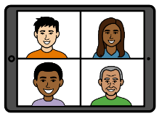
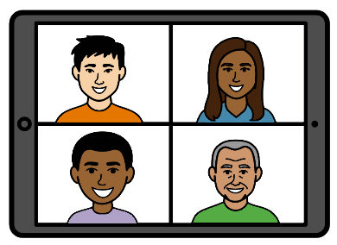
Today’s program
Team showcase 1 (Room 1 or Room 2)
Break 10 mins
Team showcase 2 (Room 1 or Room 2)
Break 10 mins
Crosscutting reflections
Panel
Closing and next steps

Slide 16
Team Showcase 1
Zoom Room 1
Zoom Room 2
Safe meals for people with swallowing difficulties
Keeping people with disability safe on farms
Safe Homes: alternatives to group home
Pleasure-centred sexual safety for neurodivergent people
Exploring the mobility safety concerns of Australians with deafblindness
Reproductive justice and neurodivergence
Stay here in this link
https://zoom.us/j/92260094567?pwd=nljToh3t662EgsnlWpaGZU1CUF5yQw.1
Meeting ID: 922 6009 4567 Passcode: 913969

Slide 17
Team Showcase 2
Zoom Room 1
Zoom Room 2
Psychological safety for children with 'behaviours of concern'
Family violence in families of children with disability in Australia
Sometimes I'm too safe: Exploring the dignity of risk
Culturally grounded safety for First Nations women with disability (pre-recoding)
Building culturally safe support for refugee communities
Barriers Within Bars: Indigenous people with disability in prison
https://zoom.us/j/96914140957?pwd=EjEfbpWuRGqZjid34EBtMRbIZPHouj.1
Meeting ID: 969 1414 0957 Passcode: 559925
https://zoom.us/j/92260094567?pwd=nljToh3t662EgsnlWpaGZU1CUF5yQw.1
Meeting ID: 922 6009 4567 Passcode: 913969

Slide 18
Zoom Room 1
Zoom Room 2
Notes:
Slide 4
Title: Senator the Hon Jenny McAllister, Minister for the National Disability Insurance Scheme

Slide 19
Team Showcase 1
Zoom Room 1
Notes:
Slide 4
Title: Senator the Hon Jenny McAllister, Minister for the National Disability Insurance Scheme

Slide 20
Safe-MEALS: Safe food, Enjoyable Meals, Advocacy and Lived Experiences
Professor Bronwyn Hemsley, The University of Technology Sydney; Fiona Given, The University of Technology Sydney, Associate Professor Deborah Debono, The University of Technology Sydney; Janice O’Connor, Partner, Onemda; Dr Anneke Jurgens, Partner, Melba Support Services; Stacey Baldac, Partner, Speech Pathology Australia; Dr Jeff Chan, Partner, consultant.

Slide 21
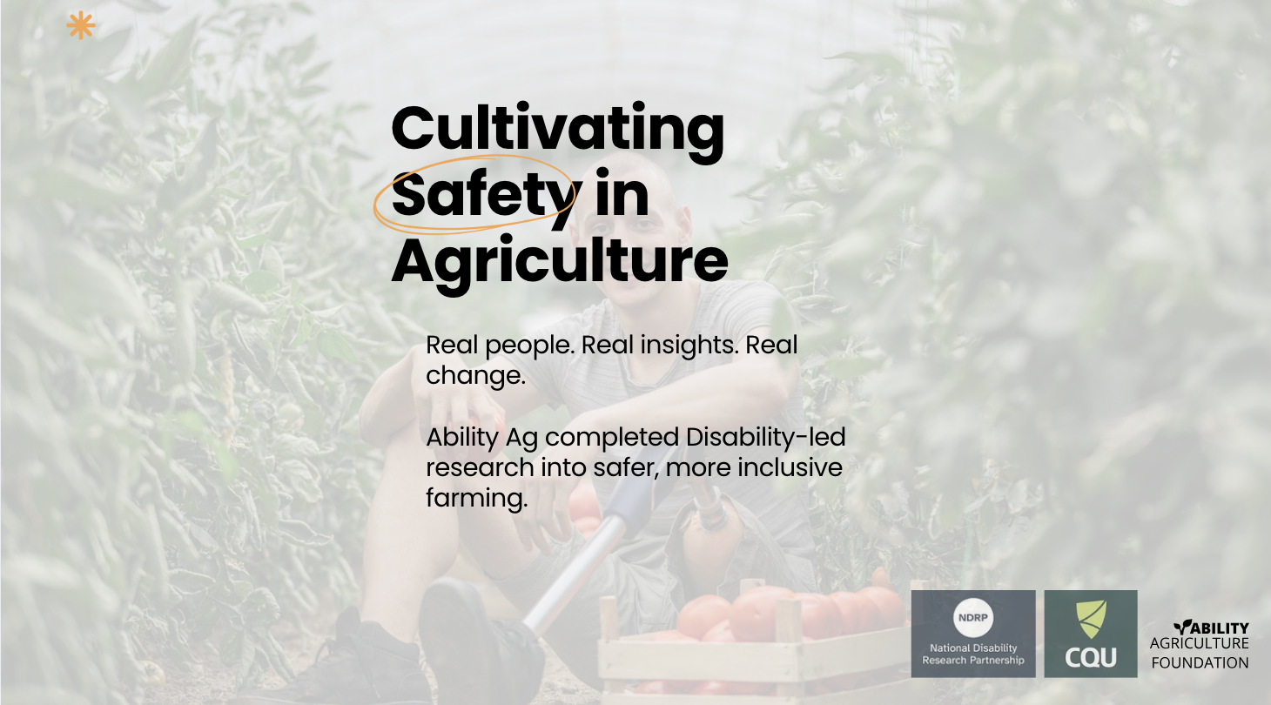
Cultivating Safety in Agriculture
Dr Josie Clarke & Nigel Corish - Ability Agriculture Foundation
Dr Nicole McDonald & Dr Pat Calusso - Central Queensland University Future Farming Institute

Slide 22
The challenge or the opportunity
Agriculture is one of Australia’s highest‑risk industries. People with disability already work, live, and contribute across farms — but safety systems rarely consider their needs.
This was the first opportunity to investigate the reality of the safety ecosystem persons with a disability have to navigate in agriculture.

Slide 23
What we did
Ecosystem approach
Persons with lived experience working in agriculture
Agribusiness employers
Farm Safety Consultants
Allied Health Professionals
Phase 1: small group and individual interviews
Phase 2: Co-design workshop - prioritising value vs impact next steps, ecosystem map review and feedback

Slide 24
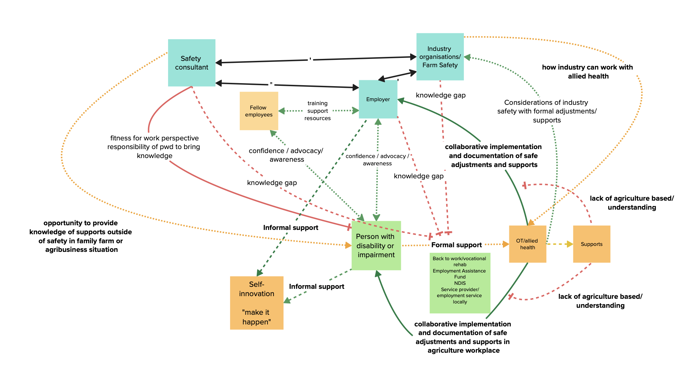

Slide 25
What are we learning
People with a Disability often Manage Risk Alone
Fear of Disclosure of asking for support/adapted task (if needed) - Reduces Safety & Increases Risk
Safety Systems and their inadaptability - “fitness for work” “safety competence & compliance”
Confidence & Capacity - Dependent on agricultural organisation size, culture and access to knowledge or support
Employers Want to Help — But Lack Formal Guidance
Persons leading change in industry - individual or family member
There are many gaps in the ecosystem - from the farm to the disability support industry
Confidence + Knowledge = Safer Outcomes

Slide 26
What helped
Community based partnership - an invaluable environment in agriculture built on learning together - key to building disability confidence as an industry
Flexibility in group vs individual interviews & feedback
9am-9pm windows navigating farming work
Value participants expertise and time (something we’re not good at in agriculture)
Strengthened capacity of community-based research

Slide 27
Final lessons
Real change only happens when solutions are built with the people they affect — grounded in lived realities, shaped by ecosystem members, and supported across the whole agricultural industry.
Think about who is “your ecosystem”? Who are your big “farms” and the small “farms”. How do we co-create solutions to ensure evidence-to-action efforts enable practical, adopted change.

Slide 28



Safe homes
Co-designing evidence for inclusive, individualised support for people with intellectual disability
Dariane
Presenters: Dariane McLean, Tess Bright, Bella White

Slide 29
The challenge or the opportunity
Dariane
Notes:
the challenge or opportunity your team addressed (DM) - 2 mins

Slide 30
Who was involved
University of Melbourne researchers: Dr Tess Bright, Bella White, Dr Kate Mason, Stef Dimov, A/Prof Zoe Aitken, Dr Cate Bailey, Prof Anne Kavanagh
University of NSW Canberra researcher: Prof Helen Dickinson
Inclusion Australia team: Dariane McLean, Amy Conley Wright, Luke Nelson, Brooke Canham
Inclusion Australia’s Complex Needs Family Reference Group
Research participants who were families and individuals using the service-for-one model
Tess
Notes:
Our team was multidisciplinary and cross sector, involving nine researchers with a range of skills and expertise, and lived experience of disability ; from UoM and UNSW listed here. From inclusion Australia we involved four people including …. And policy officers with lived experience of intellectual disability … We also involved Inclusion Australia’s complex needs family reference group, a support group for family members of people with complex support needs, facilitated by Dariane. We are also grateful to the research participants we spoke to for this research, who were family members and indiduals using the service-for one model.

Slide 31
What we did
Engaging with Inclusion Australia’s Complex Needs Family Reference Group
Co-designed research proposal submitted for funding
Funding success
Recruiting lived experience research assistant
Establishing project governance group
Partnership development and establishing the research team
Tess
Notes:
Our project had several steps. This diagram shows what we did. In purple were the steps we took before the project started whilst we applied for the co-design funding. The blue are steps we took after the project officially started.
Firstly we met with inclusion Australia to find out what their research priorities were and decide on who would be involved in the potential project
Next we came up with a few ideas which we took to IAs complex needs family reference group and got feedback
We incorporated feedback of everyone involved including the family reference group
After funding success, we recruited Bella, who will speak in a moment, as a lived experience research assistant
We established a governance group to guide the project, this included all the people in the project, and helped with project oversight and decision making throughout
Then we conducted some research activities including pilot qualitative interviews with 4 families using the service-for-one model; and a data audit of NDIS data. We obtained ethical approval to do these activities from UoM HREC.
Using the findings and lesssons from our governance meetings, interviews, and data audit we together designed a research proposal for future work in this area

Slide 32
What was achieved or is emerging
Trusted relationships that depend on stable and skilled support teams​
Reduced restrictive practices and crisis services use​
Environmental and community safeguards​
Wellbeing, choice and control, and quality of life
Tess
Notes:
What was achieved or is emerging
We wanted to ask people who use service-for-one arrangements, including family members and people with disability, about their experiences ​
We gave people different options about how they would like to participate, through speaking to us or taking or drawing pictures. They could choose tospeak to us online or in person. ​
People could take their time and participate over a few different times, and they could bring a support person if they wanted to​
Some emerging themes about the safety of the service-for-one model included. The model supported:
Trusted relationships that depend on stable and skilled support teams​
Reduced restrictive practices and crisis services use​
Environmental and community safeguards​
Together these themes contributed to a fourth key theme: Wellbeing, choice and control, and quality of life​
We also heard about the barriers and facilitators for setting up and maintaining a service for one which I won’t talk about here
I will now pass to bella to talk about the lessons we learnt in the project and key recommendations
​
​

Slide 33
What are we learning
Our partnership was a big strength of the project
Our work was strengthened through a governance group that centred lived experience
A lived experience research assistant helped embed lived experience throughout the project
It takes more time to do work that is fully inclusive, but it leads to better research
Including people with intellectual disability and high support needs in research that is about their lives is vital
Bella
Notes:
Script
Our partnership was a big strength of the project: Engaging early without a predeveloped idea ensured the research aligned with the priorities of Inclusion Australia. Inclusion Australia facilitated our engagement with families who use the service-for-one model and this shaped our project aims and methods
Our work was strengthened through a governance group that centred lived experience
A lived experience research assistant helped embed lived experience throughout the project
It takes more time to do work that is fully inclusive, but it leads to better research
Including people with intellectual disability and high support needs in research that is about their lives is vital: It is important to create safe and comfortable environments for participants and their families
It is hard for me to put into words the extent at which I have learnt over the whole process of this project, but to start off, I would like to highlight how much working with Tess to create safe and comfortable enviroments for the participants and their families has helped me to see how many other sides of research work there are. Working alongside Inclusion Australia gave me invaluable able insight into the importance of maintaining a safe enviroments through how we interact in interviews and beyond.

Slide 34
Final recommendations
Make research more accessible for people with intellectual disability (e.g. create an Easy Read list of research terms)
The NDIS is changing all the time which impacted on families in our research so we need more evidence and we need to engage with policymakers early and often
Bella
Notes:
Script
After working with Inclusion Australia (IA), the recommendations I would put forward for future projects would be to implement accessible documentation wherever possible, such as easy read language. Furthermore, disability funding is ever changing, so being able to engage with policymakers early and often would allow the families involved in our research to be less impacted.

Slide 35
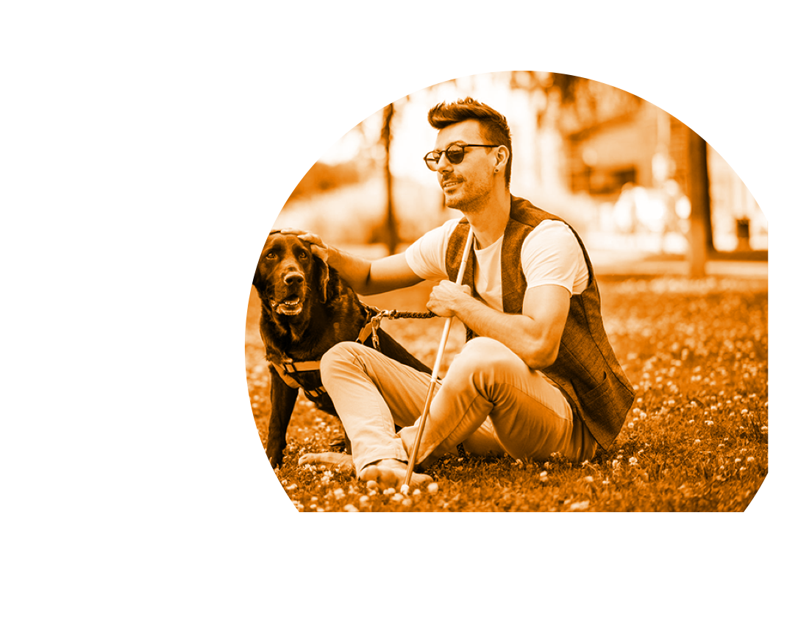
How to engage with our Research Team
Email:
Tess: brightt@unimelb.edu.au

Slide 36

Break time
Time for a 10-minute break!
✔ Stretch
✔ Grab a drink
✔ Rest your eyes
We will start again soon.
You can stay in this room or head to other link/room.

Slide 37
Team Showcase 1
Zoom Room 2
Notes:
Slide 4
Title: Senator the Hon Jenny McAllister, Minister for the National Disability Insurance Scheme

Slide 38
Developing strengths-based and pleasure-centred understandings of sexual safety for neurodivergent women, trans and gender-diverse people in Victoria
Sophie Hindes, Brigid Evans, Jacquiline den Houting, Dr Jessica Ison
The Australian Research Centre in Sex, Health & Society, Women with Disabilities Victoria, Olga Tennison Autism Research Centre, ReGEN

Slide 39
Exploring the mobility safety concerns of Australians with deafblindness
Dr Meredith Prain, Dr Sue Silveira, AssProf Kathleen Tait, Ms Heather Lawson, Mr Stephen Hallinan, Ms Melinda Carter, Ms Lisa Chen

Slide 40
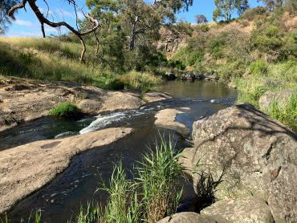
Acknowledgement of Country

Slide 41
Collaboration between:
Able Australia
NextSense
Macquarie University
Deafblind Victoria
Deafblind West Australians
Hunter Deafblind Connect

Slide 42
The challenge or the opportunity
ICF core sets for deafblindness development highlighted mobility as a major concern for people with deafblindness
Opportunity to better understand these concerns from perspective of people with deafblindness

Slide 43
What we did
Establishment of steering committee 4/7 live with deafblindness
Focus groups in Vic, NSW and WA
Thematic analysis of focus group transcripts
Confirmation of analysis from steering committee
Formulation of 3 research questions from focus group analysis
Vote on question by focus group participants

Slide 44
What are we learning
Mobility safety
  Structural issues
  Issues with vehicles
  Issues with public transport
  Human assistance
  Co-design
    Importance of relationships
    Communication support and additional time

Slide 45
What helped
Strong State based DB groups
Relationships – Lead researcher and State based groups, and steering committee with members of State based groups
Experience of lead researcher in facilitating groups of people with deafblindness
Adequate and prepared communication supports

Slide 46
Final lessons
Key research priorities:
  What do orientation and mobility specialists, communication guides and public transport staff need to know about deafblindness to improve mobility safety of people with deafblindness
  Research with people with deafblindness
    Form and leverage relationships with deafblind led peer groups
    Ensure additional funding for communication support and time, to ensure inclusion and participation

Slide 47
How to engage with our Research Team
Email:
meredith.prain@ableaustralia.org.au

Slide 48
Reproductive justice and neurodivergence: A participatory approach to addressing structural inequity
Moulton, J., O’Donovan, A., Pike, A., Arnstein-Kerslake, A., Merner, B., Haining, C., Kirby, C., Toulmin, C., Sutherland, G., La Paglia, H., Hargrave, J., Miles, J., Whelan, K., Noble, K., Witteveen, K., Steele, L., Keogh, L., Prior, M., Viktor, O., Grove, R., Spencer, R., Power, R., Timperley, S., Odoi, S., Dimov, S., & Moodie, T.
University of Melbourne; Sexual Health Quarters; Sexual Health Victoria; University of Technology Sydney; University of Queensland.

Slide 49
Break time
Time for a 10-minute break!
✔ Stretch
✔ Grab a drink
✔ Rest your eyes
We will start again soon.
You can stay in this room or head to other link/room.

Slide 50
Stay here or change links
Notes:
Slide 4
Title: Senator the Hon Jenny McAllister, Minister for the National Disability Insurance Scheme

Slide 51
Team Showcase 2
Notes:
Slide 4
Title: Senator the Hon Jenny McAllister, Minister for the National Disability Insurance Scheme

Slide 52
List and links
Zoom Room 1
Zoom Room 2
Psychological safety for children with 'behaviours of concern'
Family violence in families of children with disability in Australia
Sometimes I'm too safe: Exploring the dignity of risk
Culturally grounded safety for First Nations women with disability (pre-recoding)
Building culturally safe support for refugee communities
Barriers Within Bars: Indigenous people with disability in prison
https://zoom.us/j/96914140957?pwd=EjEfbpWuRGqZjid34EBtMRbIZPHouj.1
Meeting ID: 969 1414 0957 Passcode: 559925
https://zoom.us/j/92260094567?pwd=nljToh3t662EgsnlWpaGZU1CUF5yQw.1
Meeting ID: 922 6009 4567 Passcode: 913969

Slide 53
Zoom Room 1
Notes:
Slide 4
Title: Senator the Hon Jenny McAllister, Minister for the National Disability Insurance Scheme

Slide 54
Psychological Safety of Children with Disability Labelled with ‘Behaviours of Concern’
Lead organisation: University of Melbourne
Partner organisations: Yellow Ladybugs; Heads Together for Brain Injury
Project team: A/Prof Sarah Knight, Dr Nicole Merrick, Prof Christine Imms, A/Prof Matt Harrison, A/Prof Lisa McKay-Brown, Chelsea Aquilina, Heather Renton, Juanita Mulholland, Cat Lancaster, Kate Heine, Natasha Staheli and Katie Koullas.

Slide 55
The challenge or the opportunity
My mainstream primary school was pretty supportive: people listened, cared and tried to understand what I needed to be safe and included. But mainstream high school was completely different. I felt judged and criticised for my ‘behaviour’ which was actually panic attacks and seizures. I became so scared and upset that I started hurting myself and even thinking about suicide, and I had to stop attending school.

Slide 56
What we did
Four co-design workshops
1. NOW: Map current experiences
2. WOW: Imagine safer, rights-based support
3. NOW to WOW: Refine questions, methods and partners
4. HOW: Shape study design, risks, timeline and funding

Slide 57
What are we learning
Five key learnings
1 Behaviour is communication
2 Everyday interactions shape psychological safety
3 Language can reduce (or reinforce) stigma
4 Lived experience redirects research
5 Co-design itself should be evaluated

Slide 58
What helped
Relationships first
Co-designed psychological safety and distress protocols
Flexible participation
Shared power
Ongoing flexibility
Being part of this research team is the first time I’ve felt like I had a voice, am respected and valued for my lived experience and knowledge. It’s made me passionate about creating real solutions so that young people like me feel safer and more valued in their schools.

Slide 59
Final lessons
Five lessons for future co-design
1 Invest in process
2 Clarify roles and expectations early
3 Build in regular checkpoints
4 Keep lived experience central
5 Link co-design to policy and practice
Next steps
Two Master of Psychology students are:
• Evaluating our co-design process
• Conducting a scoping review of psychological safety for children with disability

Slide 60
How to engage with our Research Team
sarah.knight@unimelb.edu.au
Project focus; Safe, inclusive and rights-based schools for students with disability.
Notes:
We welcome conversations with people with disability, families, schools, education systems, policymakers, advocates and researchers interested in strengthening psychological safety for students with disability.
Please contact A/Prof Sarah Knight at sarah.knight@unimelb.edu.au. The project focuses on safe, inclusive and rights-based school environments for children and young people with disability.

Slide 61
Safety Beyond Barriers (SBB) Project: Diverse experiences of family violence among children and young people with disability
Lead organisation: Children and Young People with Disability Australia (CYDA)
Partner: Australian Institute of Family Studies (AIFS)
Madeleine Gay| CYDA | Acting Policy and Research Lead |
SBB Project Support Officer

Slide 62
The challenge and opportunity: genuine co-design
Embedding genuine co-design across the whole project cycle.
What is co-design?
Co-design is a way of working together to create something new. The ‘co’ means collaboration; the ‘design’ means making.
In research, co-design involves people with lived experience working alongside researchers to shape research questions, methods, tools, and outcomes.
It’s about people with lived experience/expertise being part of the team, making decisions, and helping shape what gets built, tested, and shared. It’s creative, flexible, and based on trust.*
* https://www.ndrp.org.au/resources/co-design

Slide 63
What we did
The project brought together co-designers with lived experience of disability, family and domestic violence (FDV) and diverse life experiences to shape a research proposal for a future study.
The co-designers were involved in:
A preparatory session
Three co-design sessions over six months
Review of the final research proposal

Slide 64
What are we learning
It was challenging to fully represent the diversity of experiences.
Genuine co-design requires time, resourcing and getting the 'right people' in the room.
Recognise that disclosure is complex, negotiated and ongoing.

Slide 65
What helped
Appointed lived expertise facilitators and safety and wellbeing officers.
Set clear boundaries around disclosure and created a safe space to reflect
Established "working together agreements" to clarify roles and provide transparency about decision-making power.

Slide 66
Final lessons
Genuine co-design takes time.
Flexible and accessible communication channels are essential, especially when things change.
Researching sensitive topics safely requires constant reflection and adaptability.

Slide 67
Important messages for policy, practice and community
Children and young people with disability are victim-survivors in their own right.
Their voices must be heard and centered in research, policy and services.
Co-designed research is essential to creating solutions that work in practice.
To learn more, visit: Safety Beyond Barriers Project

Slide 68
How to engage with our Research Team
Dr Liz Hudson, Project Co-lead, CYDA Head of Policy and Research: lizhudson@cyda.org.au
Dr Tess Altman, Project Co-lead, CYDA Policy and Research Lead: tessaltman@cyda.org.au
Madeleine Gay, Project Support, CYDA Acting Policy and Research Lead: madeleinegay@cyda.org.au

Slide 69
Sometimes I'm too safe. Exploring the dignity of risk with adults with intellectual disability
Team names:
Rhonda Faragher, Jan Lloyd, Karen Nankervis, Mitch Toohey, Ruth Faragher
Additional research staff:
Claire Mitchell, Alana Pettigrew, Callum Scanlon, Rachel Aberdein
Partners:
Darryl Steff (DSA), Sarah Bone & Claire Robinson (DSIDQ)
Simone Johnston (QDH)
Notes:
Rhonda
Presenting today: Rhonda, Jan, Mitch, Ruth, Claire

Slide 70
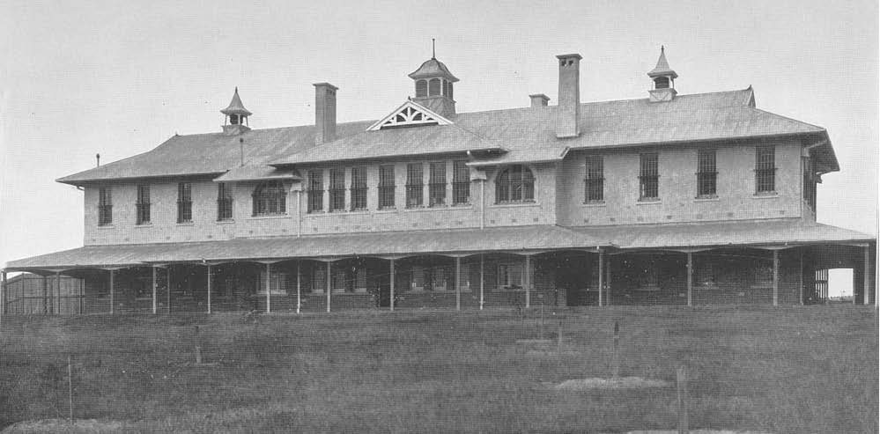
Acknowledgement
In the past, research was done ON people with disability without their consent.
We acknowledge poor practice of the past and remember those who suffered as a result.
We strive to make all research we do to be WITH and BY people with intellectual and developmental disabilities.
Notes:
Rhonda

Slide 71
The challenge or the opportunity
Lots of people care about keeping people with intellectual disability safe.
Sometimes people can be too safe:
  They might not be allowed to take risks
  They might not be allowed to make mistakes
  They might not have the chance to learn from life experience
People with intellectual disability want to:
  Make choices
  Try new things
We want to find out how to balance safety with autonomy.
Notes:
Mitch – blue
Ruth – orange
Claire – pink
Rhonda – purple
Jan - brown

Slide 72
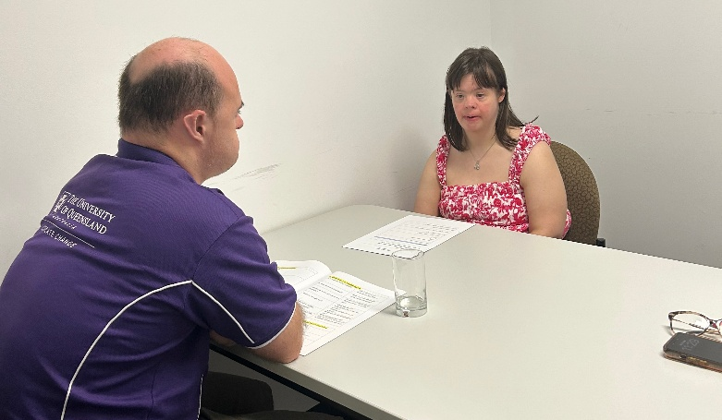
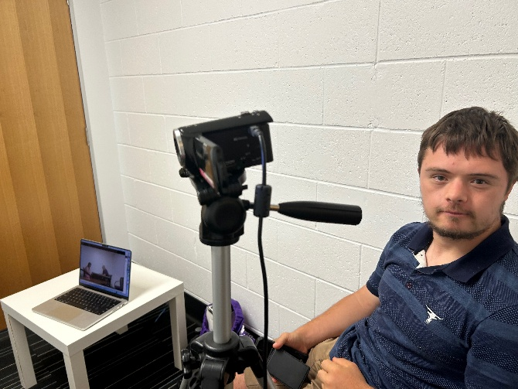
What we did
We planned a research study
We will interview people with intellectual disability.
We wrote interview questions.
We tried out our questions in trial interviews.
We recorded our interviews.
We changed our questions lots of times.
We used the questions to make a survey for parents and support workers.
Notes:
Mitch – blue
Ruth – orange
Claire – pink
Rhonda – purple
Jan - brown

Slide 73
What we are learning – five key ideas
Co-design makes research better
Doing inclusive research takes:
  Time
  Training
  Ongoing support
Participants with intellectual disability like being interviewed by researchers with intellectual disability
In person interviews were better than online interviews
University systems, like pay and HR, need to be more accessible
Notes:
Ruth
Rhonda
Mitch
Claire
Jan
Mitch – blue
Ruth – orange
Claire – pink
Rhonda – purple
Jan - brown

Slide 74
What helped
NRDP funding
Employing a team of people with intellectual disability
Funding time for staff with research qualifications to be active at all stages – NDRP funding + UQ in-kind support
Supportive administrative environment – also willing to improve
Partners
Notes:
Jan
[res quals – expensive but necessary for us to be at all sessions – can’t be left to RAs]

Slide 75
Final lessons
Inclusive research is a collaboration.
Different researchers bring different expertise.
  Not everyone does everything
Funding development of research proposals = better research
Notes:
Rhonda

Slide 76
How to engage with our Research Team
Email:
dsrp@uq.edu.au
r.faragher@uq.edu.au

Slide 77
Break time
Time for a 10-minute break!
✔ Stretch
✔ Grab a drink
✔ Rest your eyes
We will start again soon in the main Zoom Room link.

Slide 78
Zoom Room 2
Notes:
Slide 4
Title: Senator the Hon Jenny McAllister, Minister for the National Disability Insurance Scheme

Slide 79
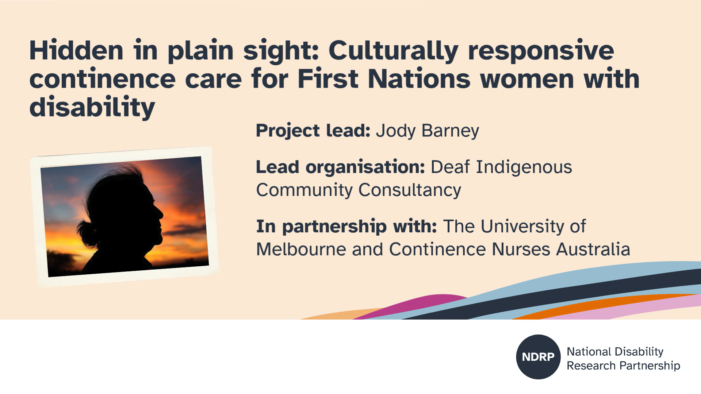

Slide 80
Co-designing research to build regional capacity for culturally safe access to supports and services for people with disability from refugee communities
Angela Dew, Kim Robinson, Andrew Brown, Kaye Graves, Sarah Tarquinio, Nido Taveesupmai, Zahir Azimi, Stephanie Flynn, Tamara Davis, Amanda Shearson, Si Blut Soe, Paw Htoo May, Cherry Sein, Masooma Mohammad, Sadia Sadia, Fatima Seyedi

Slide 81
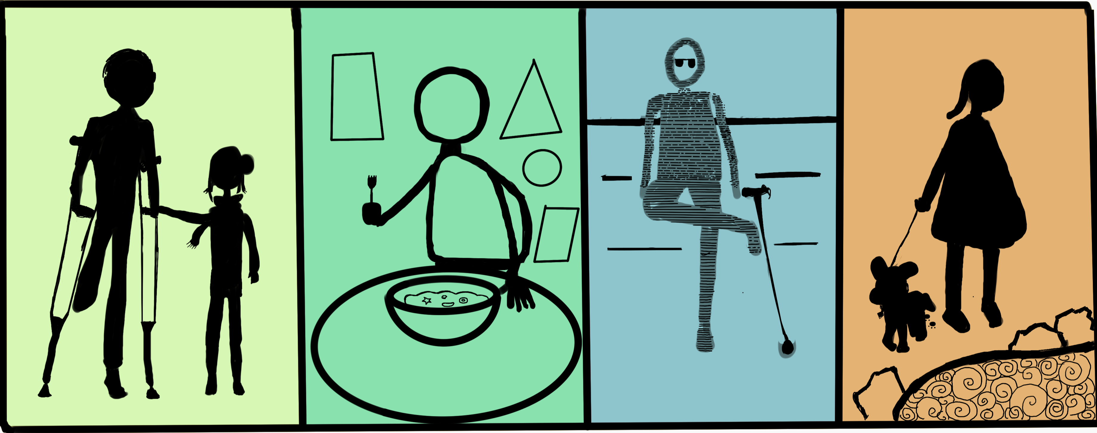
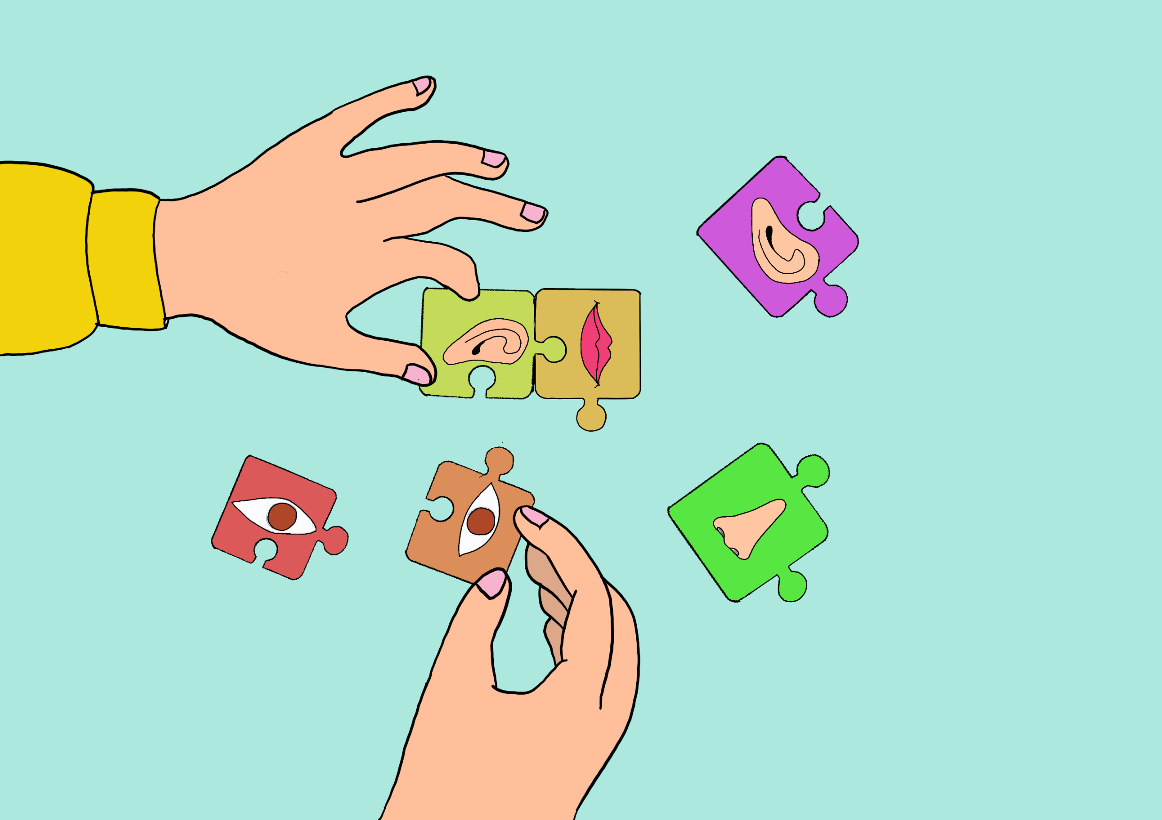
The opportunity and the challenge
Increasing numbers of people with disability from refugee backgrounds settling in Australia.
People need culturally safe access to disability and other services.
Multiple interacting systemic factors create cultural safety challenges.
Co-design action research to improve cultural safety.
Original artwork by Karen artist Ta Na Moo
Original artwork by Afghan Hazara artist Sakineh Mohammadi

Slide 82
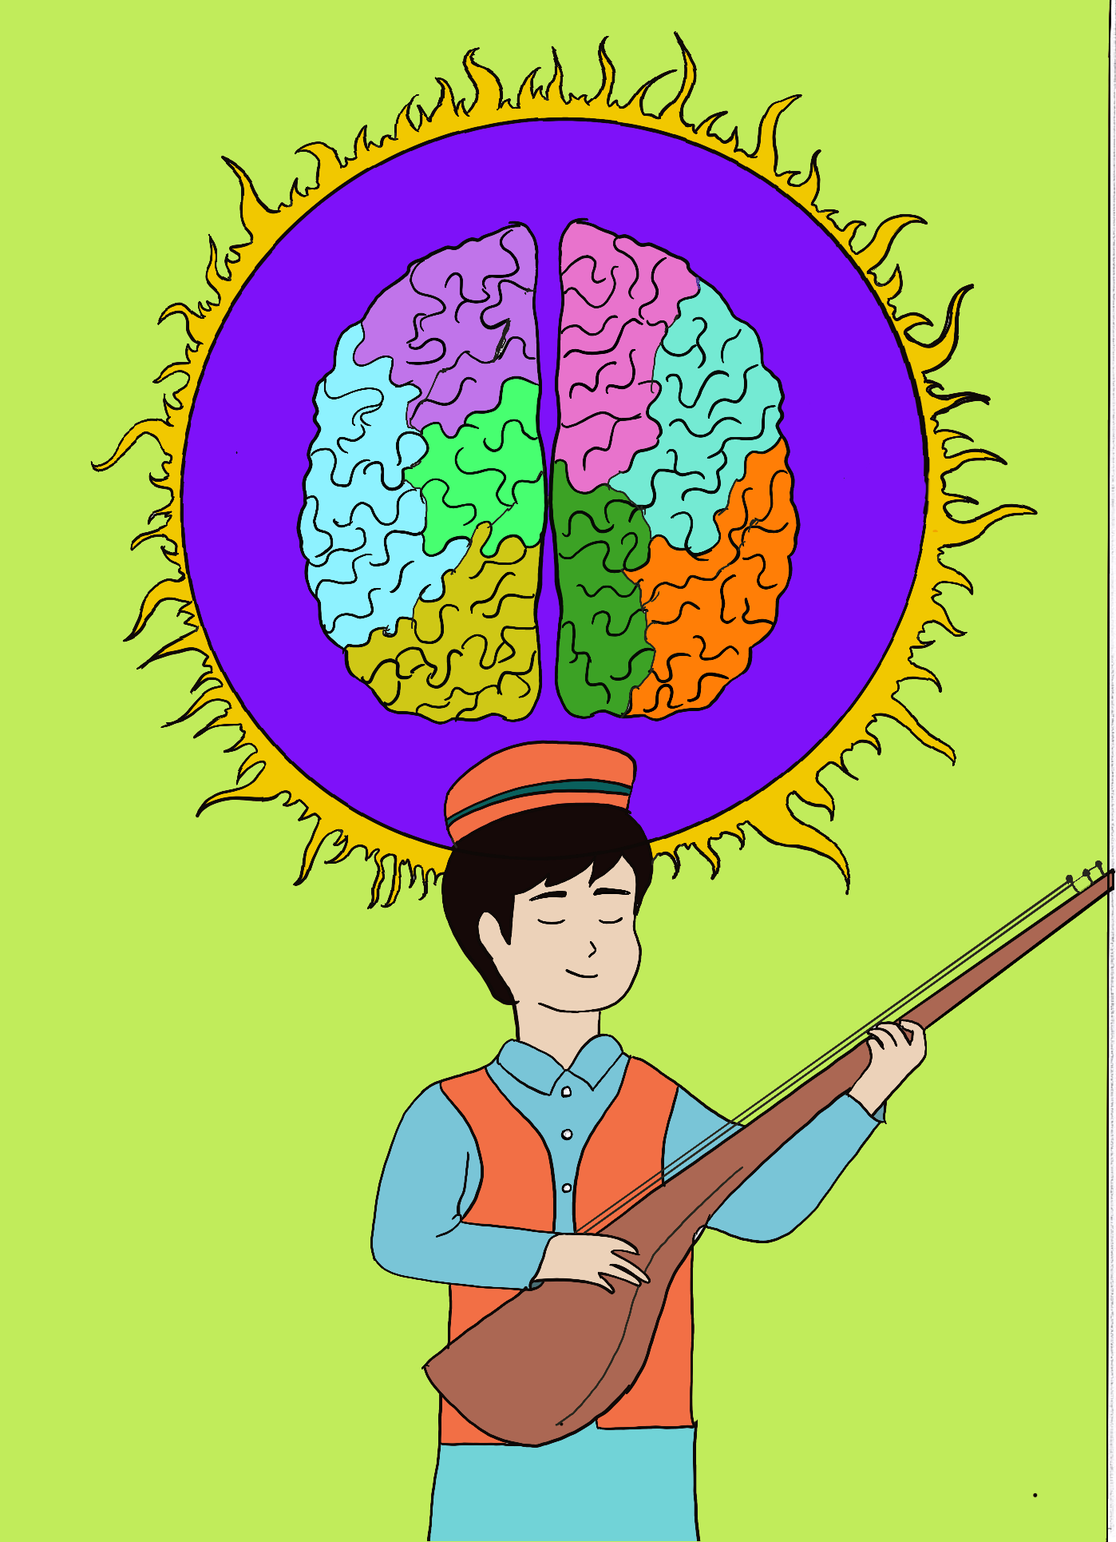
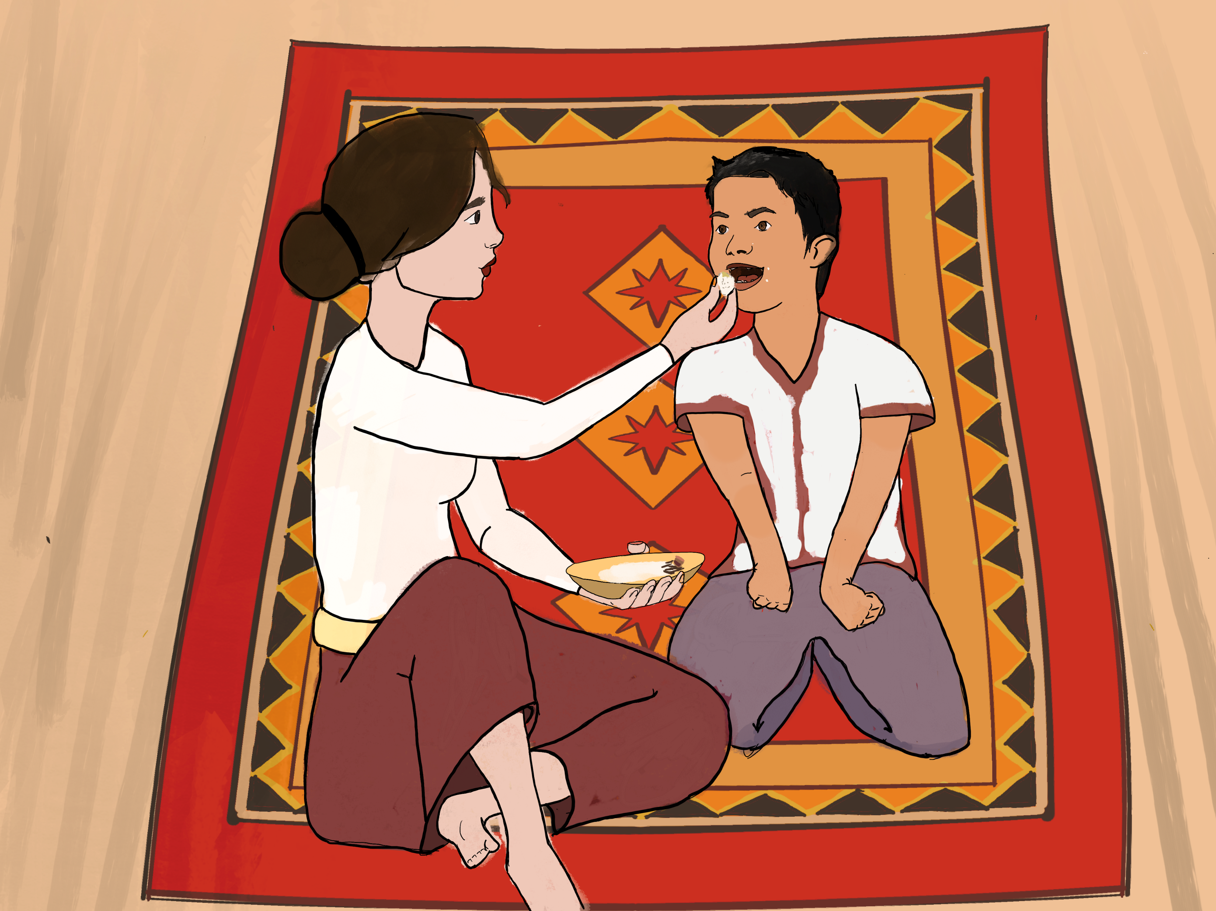
What we did
Participatory co-design and systems thinking approaches
Across three cultural groups and languages
Three action research rounds: advisory group input – individual interviews – co-design group
Original artwork by Karen artist Ta Na Moo
Original artwork by Afghan Hazara artist
Sakineh Mohammadi

Slide 83
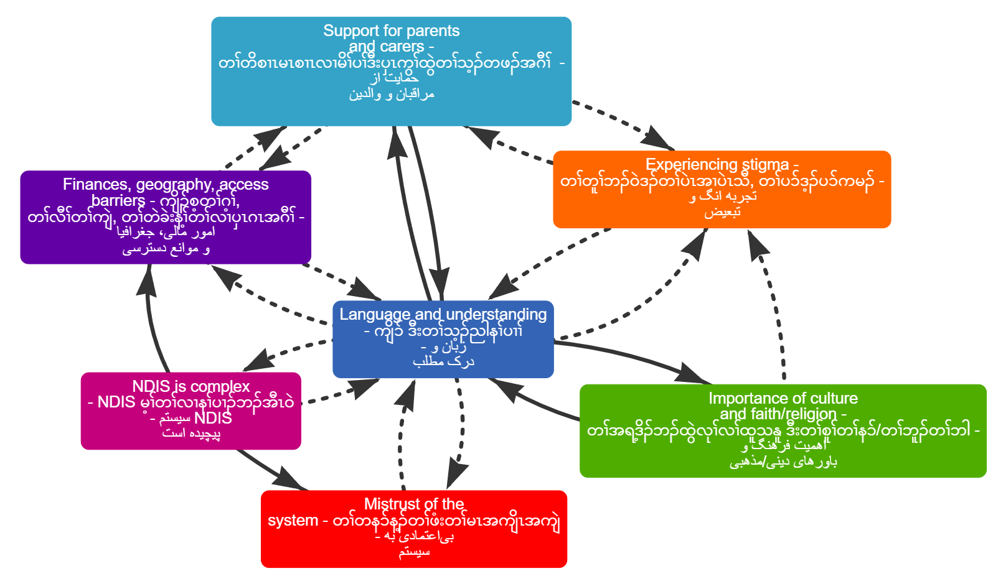
What are we learning
Value of working across three languages and cultural groups
Navigating challenges of working across three languages and cultural groups
Interconnections between issues

Slide 84
What helped
Built on previous BCHS research
Engagement with Karen and Hazara community members at all stages
Allowing time
Everyone learnt and everyone contributed

Slide 85
Final lessons
Bi-cultural / peer workers: considering how to support their key roles in systems while providing key support to avoid burnout
Practising strategies in real time (for example, putting languages side by side in systems maps)
Value of multiple forms of communication in practice

Slide 86
How to engage with our Research Team
Email: angela.dew@deakin.edu.au; andrew.brown@deakin.edu.au; kim.robinson@deakin.edu.au

Slide 87
Barriers within Bars
A/Prof Sheelagh Daniels-Mayes (University of Melbourne)
Dr Aunty Roslyn Sackley (AccessAble Braille Enterprises)
Dr Sharon Kerr (University of Melbourne)
Mr Eyayu Kasseye Bayu ( PhD Candidate University of Melbourne)

Slide 88
The challenge
The system is failing Indigenous people with disability at every stage of the justice system. “Disability is often unrecognised, misunderstood or punished, and prison environments are not designed to meet the needs of people with disability.”
Key challenges:
Indigenous perspective of disability →disability often undiagnosed or supported
Disability misrecognition → criminalisation rather than support
High and increasing remand rates
Culturally unsafe prison healthcare
Communication barriers affecting safety and justice
Fragmented reintegration supports
Almost no research at the intersection of Indigeneity + disability (only 18 studies mapped)

Slide 89
What we did
We began a national conversation and produced the first consolidated evidence synthesis at this intersection.
Activities:
Rapid evidence review (177 studies mapped)
Three co‑design focus groups
Individual interviews with ATSILS and VALS
Lived experience validation of emerging themes
Accessibility embedded: Easy English, alternative formats, Braille production
The project was led by Indigenous researchers with disability… ensuring cultural authority, disability knowledge and lived experience guided every stage of the work.

Slide 90
Final lessons
We already know what needs to change — but evidence isn’t being acted on. “The problem is not a lack of research but a lack of implementation.”
Royal Commissions and inquiries repeat the same findings, yet disability‑related behaviours continue to be punished rather than supported.
Future research must extend beyond prisons to the full justice pathway — including child protection, out‑of‑home care, school exclusion and early policing.
A lifespan approach is essential: early system contact sets up predictable pathways into youth justice and adult custody.
Indigenous disability leadership must drive the next phase to ensure evidence leads to action, not another cycle of ignored recommendations.

Slide 91
How to engage with our Research Team
  Email:Sharon.kerr@unimelb.edu.au
  0487104391

Slide 92
Break time
Time for a 10-minute break!
✔ Stretch
✔ Grab a drink
✔ Rest your eyes
We will start again soon in the main Zoom Room link.

Slide 93
Please return to the main room
Notes:
Slide 4
Title: Senator the Hon Jenny McAllister, Minister for the National Disability Insurance Scheme

Slide 94
Evidence to action
Cross cutting reflections
Facilitator: Mayer Sayers
Notes:
Slide 15
Title: Evidence to action: Resourcing partnerships fairly
Facilitator: Mayer Sayers
The lower right-hand side of the slide includes the NDRP logo and the lower half of the slide includes a multi coloured NDRP brand with sweeping lines.

Slide 95
Evidence to action
What worked well and lessons learned
Panel: Josie Clarke, Tess Bright and Bella White
Facilitator: Mayer Sayers
Notes:
Slide 15
Title: Evidence to action: Resourcing partnerships fairly
Facilitator: Mayer Sayers
The lower right-hand side of the slide includes the NDRP logo and the lower half of the slide includes a multi coloured NDRP brand with sweeping lines.

Slide 96

Final takeaway
What is one idea or message you want to keep from today?
✔ Write it in the chat
✔ One word or short phrase is great
Notes:
Slide 11
Final takeaway
What is one idea or message you want to keep from today?
✔ You can say it out loud
✔ Or write it in the chat
✔ One word or short phrase is great

Slide 97


How to engage with the NDRP
Email: info@ndrp.org.au
Phone: 03 9000 3813 SMS only number: 0485 931 168
Subscribe to our newsletter at www.ndrp.org.au for updates
Follow us on Facebook and LinkedIn
Notes:
Slide 5
Title: How to engage with the NDRP
Decorative icons and text reads:
Email: info@ndrp.org.au
Phone: 03 9000 3813
SMS only number: 0485 931 168
Subscribe to our newsletter at www.ndrp.org.au for updates
Follow us on Facebook and LinkedIn
END

