Slide 1
Information sessions
2026 Disability Research Leadership Program Fellowships

Slide 2
Acknowledgement of Country
The NDRP acknowledges the traditional custodians of Country throughout Australia. The peoples on whose land we live and work, have lived on and cared for Country for thousands of generations, and this land has never been ceded. We pay our respects to them and their cultures, and to Elders past and present.
Notes:
Slide 2
Title: Acknowledgement of Country
The NDRP acknowledges the traditional custodians of Country throughout Australia. The peoples on whose land we live and work, have lived on and cared for Country for thousands of generations, and this land has never been ceded. We pay our respects to them and their cultures, and to Elders past and present.

Slide 3
Agenda for this Q&A session
About the NDRP and the Disability Research Leaders Program (DRLP)
2026 Fellowship Details
Eligibility (applicants & host institutions)
Assessment Criteria
How to apply and Checklist
Open forum for questions
Reminders and next steps
Notes:
Slide 5
Title: Knowledge
evidence from academic and community-based research,
information, insights and story held by people and communities because of their lived, cultural, service and/or systems experience, and
expertise from practice.

Slide 4
National Disability Research Partnership (NDRP)
The NDRP is an independent organisation that funds and supports disability research by and with people with disability
Funded by the Australian Government Department of Health Ageing and Disability
https://www.ndrp.org.au
Notes:
Slide 5
Title: Knowledge
evidence from academic and community-based research,
information, insights and story held by people and communities because of their lived, cultural, service and/or systems experience, and
expertise from practice.

Slide 5
Disability Research Leadership Program (DRLP) Fellowships
The intended outcomes for participants in the program are to:
strengthen career progression and profile,
connect with a community of peers to share and learn from each other,
access professional learning opportunities and connections with other people in government, policy and practice, disability research and disabled persons and representative organisations they would not have otherwise had access to, and
strengthen practice in high-quality disability-led and inclusive research that has an impact on disability policy and practice.
Notes:
Slide 5
Title: Knowledge
evidence from academic and community-based research,
information, insights and story held by people and communities because of their lived, cultural, service and/or systems experience, and
expertise from practice.

Slide 6
Disability Research Leadership Program (DRLP) Fellowships
The intended outcomes for the NDRP are to:
support postdoctoral research activities that are aligned with the NDRP Principles and Research Agenda,
build an evidence base on the barriers and enablers for postdoctoral fellows with disability through the evaluation of the program learning,
improve the recognition of researchers with disability in the research sector for their expertise and contributions, and
strengthen pathways for researchers with disability into leadership roles in academia.
Notes:
Slide 5
Title: Knowledge
evidence from academic and community-based research,
information, insights and story held by people and communities because of their lived, cultural, service and/or systems experience, and
expertise from practice.

Slide 7
Program Details
$110,000 per year toward the fellow's salary and oncosts. Host institutions are expected to top up where required
Up to $60,000 in flexible funding for research and professional development - min of 25% (at least $15,000) of this is to be spent on professional development
national community of practice supported by the NDRP for the first year of the program, for the following year, fellows will be supported to self-organise peer networking
Additional learning and development sessions, and networking opportunities may also be offered by NDRP
Notes:
Slide 5
Title: Knowledge
evidence from academic and community-based research,
information, insights and story held by people and communities because of their lived, cultural, service and/or systems experience, and
expertise from practice.

Slide 8
Program Details
NDRP provides funding and Host Institution is the employer
Can be full time or part time - length of Fellowship is 2 years for both
Part time is minimum 0.5 FTE (half a full time working arrangement) and salary contribution is prorated. Flexible funding for research and professional development is also prorated.
Expectation to attend at least six community of practice sessions over the first year
Notes:
Slide 5
Title: Knowledge
evidence from academic and community-based research,
information, insights and story held by people and communities because of their lived, cultural, service and/or systems experience, and
expertise from practice.

Slide 9
What the research and professional development funding can be used for
Examples of how this funding could be used include:
direct research costs (including payment of participants, software costs, research related equipment),
travel, accommodation and registration to attend or present work at conferences,
training, mentoring, or professional development courses,
knowledge translation or knowledge mobilisation costs,
placements or collaborations with a Disability Representative Organisation,
equipment that cannot be funded from other sources such as the NDIS or the university
activities that strengthen involvement or leadership of people with disability in the research project, or
accessibility-related activities for participants involved in your research.
Notes:
Slide 5
Title: Knowledge
evidence from academic and community-based research,
information, insights and story held by people and communities because of their lived, cultural, service and/or systems experience, and
expertise from practice.

Slide 10
What the research and professional development funding cannot be used for
Funds cannot be used for :
tuition fees
overheads
costs that other parts of government pay for such as the National Disability Insurance Scheme (NDIS), Medicare
or accessibility adjustments that should be provided by the host institution.
Notes:
Slide 5
Title: Knowledge
evidence from academic and community-based research,
information, insights and story held by people and communities because of their lived, cultural, service and/or systems experience, and
expertise from practice.

Slide 11
Timelines
Application Form Open
10 Aug 2026
Application Form closes
21 Sep 2026
5pm AEST
Assess applications
Sep-Oct 2026
Notify Successful Candidates
26 Oct 2026
Fellowships start November 2026
Fellowships finish November 2028
Online Interviews with Shortlisted Candidates
October 2026
Host Institutions confirmed agreement to host & PhD evidence
20 Nov 2026
2 Years

Slide 12
Who is Eligible?
be a person with disability
be an Australian citizen or permanent resident
have met all requirements for the award of their PhD by the time of application
be within seven years of completing their PhD at the time of application (career breaks and disruptions will be considered)
have a nominated supervisor or mentor willing to support at a host institution; and provide a letter from them confirming this support
have a host institution confirm that it is willing to employ and supervise the applicant and top up salary if required (confirmation not required at application)
Notes:
Slide 5
Title: Knowledge
evidence from academic and community-based research,
information, insights and story held by people and communities because of their lived, cultural, service and/or systems experience, and
expertise from practice.

Slide 13
Who is Eligible? continued
have a proposed research project with objectives and outcomes aligned with the NDRP Principles and Research Agenda and contributing to improving the lives of people with disability
not be in receipt of another postdoctoral fellowship that provides a salary contribution covering the same period as this fellowship, unless that funding is solely to top up the fellow's salary to their required level of appointment
give consent to being identified as a recipient of the DRLP Fellowship in public communications about the program
commit to engaging in the program activities and the evaluation of the DRLP Fellowships
Notes:
Slide 5
Title: Knowledge
evidence from academic and community-based research,
information, insights and story held by people and communities because of their lived, cultural, service and/or systems experience, and
expertise from practice.

Slide 14
Eligible Host Institutions
have a current Australian Business Number (ABN)
have documented organisational and financial policies and procedures
have a business and/or strategic plan
have an annual report
have insurances, including public liability insurance and professional indemnity
comply with all relevant state/territory and Australian legislation and standards relevant to the project including working with children requirements
not be named in the “Institutions that have not joined or signified their intent to join the Scheme” list of the National Redress Scheme for Institutional Child Sexual Abuse (www.nationalredress.gov.au)
have in place existing policies and systems that comply with the Australian Code for the Responsible Conduct of Research, or have these through a formal partnership with an organisation on the project team that does have these in place.
Notes:
Slide 5
Title: Knowledge
evidence from academic and community-based research,
information, insights and story held by people and communities because of their lived, cultural, service and/or systems experience, and
expertise from practice.

Slide 15
Confirming Host Institution & PhD Completion
No fellowship can commence without a confirmed host institution in place by 20 November 2026.
Prior to execution of a funding agreement, successful applicants must by 20 November 2026:
provide confirmation from the host institution that it agrees to host the fellowship and meet the host institution requirements (Organisations must be legally able to enter into a funding agreement with the NDRP)
provide evidence that all requirements for the award of the PhD have been met
Note this step is only for successful applicants and evidence of either is not required for the application
Notes:
Slide 5
Title: Knowledge
evidence from academic and community-based research,
information, insights and story held by people and communities because of their lived, cultural, service and/or systems experience, and
expertise from practice.

Slide 16
Ethics and Research Governance
Projects involving human participants must obtain approval from a recognised Human Research Ethics Committee (HREC) before starting any data collection.
Where a project does not require full HREC review, applicants should obtain written confirmation of exemption from their institution's ethics body.
All projects must comply with the Australian Code for the Responsible Conduct of Research.
Note applicants do not need ethics approval at the time of application.
Notes:
Slide 5
Title: Knowledge
evidence from academic and community-based research,
information, insights and story held by people and communities because of their lived, cultural, service and/or systems experience, and
expertise from practice.

Slide 17
How applications will be assessed
Eligibility screening
Assessment by independent review panel members
  Applications will be considered against the published assessment criteria
  TIP: read the Assessment Matrix for Applicants on the information page
Online interviews with shortlisted applicants
Recommendations made to the NDRP Board
NDRP Board makes final decision on Fellowship participants
All applicants will be notified of the outcome by email
Feedback will be offered to applicants to support future opportunities
Notes:
Slide 5
Title: Knowledge
evidence from academic and community-based research,
information, insights and story held by people and communities because of their lived, cultural, service and/or systems experience, and
expertise from practice.

Slide 18
Assessment criteria
1. Connection of your proposed research to the NDRP Principles and Research Agenda. (40% weighting)
2. Potential impact of the program on you and your career (30% weighting)
3. Experience and readiness to make the most of this opportunity (30% weighting)
Other information you would like to provide to support your application

Slide 19
Criterion 1: Connection to the NDRP Principles and Research Agenda
40%
Up to 600 words
This criterion looks at how well the proposed research connects to the NDRP Principles and Research Agenda, how it will be co-designed and produced with people with disability, and how it can contribute to changes in policy, practice or programs that benefit people with disability.
Notes:
Slide 5
Title: Knowledge
evidence from academic and community-based research,
information, insights and story held by people and communities because of their lived, cultural, service and/or systems experience, and
expertise from practice.

Slide 20
Criterion 1: Connection to the NDRP Principles and Research Agenda
Strong applications will:
Clearly describe the proposed research and what it will deliver by the end of the fellowship.
Explain how the proposal was developed, including any consultation or co-design with people with disability, a Disability Representative Organisation, or other groups.
Show clear alignment with the NDRP Principles and Research Agenda, and describe the benefits for people with disability, including potential contribution to policy, practice or programs.
Explain how the research will be co-designed and produced by people with disability.
Outline a clear plan for sharing findings with people with disability and the wider community.
Describe how the nominated supervisor or mentor will support the research.
Notes:
Slide 5
Title: Knowledge
evidence from academic and community-based research,
information, insights and story held by people and communities because of their lived, cultural, service and/or systems experience, and
expertise from practice.

Slide 21
Criterion 2: Potential impact of the program on you and your career
30%
Up to 500 words
This criterion looks at how the fellowship would support the applicant's research and career development, how it addresses barriers they face, and how they would use the experience to keep contributing to disability-led, inclusive research.
Notes:
Slide 5
Title: Knowledge
evidence from academic and community-based research,
information, insights and story held by people and communities because of their lived, cultural, service and/or systems experience, and
expertise from practice.

Slide 22
Criterion 2: Potential impact of the program on you and your career
Strong applications will:
Explain how the program would support career progression and address current barriers to progressing a research career. This may include factors relating to disability or other factors including job security or being able to secure an inclusive workplace.
Provide a clear, high-level overview of how the research and professional development funding would be used.
Describe how the experience would be used to continue contributing to disability-led, inclusive research in the future.
Notes:
Slide 5
Title: Knowledge
evidence from academic and community-based research,
information, insights and story held by people and communities because of their lived, cultural, service and/or systems experience, and
expertise from practice.

Slide 23
Criterion 3: Experience and readiness to make the most of this opportunity
30%
Up to 400 words
This criterion looks at the applicant's experience and commitment to a career in disability research, the skills and perspectives they bring, and their readiness to make the most of the program.
Notes:
Slide 5
Title: Knowledge
evidence from academic and community-based research,
information, insights and story held by people and communities because of their lived, cultural, service and/or systems experience, and
expertise from practice.

Slide 24
Criterion 3: Experience and readiness to make the most of this opportunity
Strong applications will:
Describe relevant experience and commitment to building a career in disability research, including research outputs to date. Outputs may include publications, reports, presentations, policy impacts, community resources and other contributions. Outputs look different for different researchers, and disability may affect the type, number or timing of outputs.
Explain the skills and perspectives they would contribute to the program and the community of practice.
Describe what they would do to make the most of the program and engage with the opportunities available.
Notes:
Slide 5
Title: Knowledge
evidence from academic and community-based research,
information, insights and story held by people and communities because of their lived, cultural, service and/or systems experience, and
expertise from practice.

Slide 25
Optional: Other information you would like to provide to support your application
Up to 300 words
Optionally, this gives you space to add anything else you would like us to know to support your application, e.g.
  Any additional experiences or achievements that you have not had a chance to mention in the other criteria and think would strengthen your application.
  Any future goals not mentioned elsewhere that you think are relevant.
Notes:
Slide 5
Title: Knowledge
evidence from academic and community-based research,
information, insights and story held by people and communities because of their lived, cultural, service and/or systems experience, and
expertise from practice.

Slide 26
How to apply
Application form opens 10 August 2026
Applications close 21 September 2026, 5pm AEST
We use SmartyGrants to manage the application process:
  https://ndrp.smartygrants.com.au/DRLPIntake2
Supporting resources: https://content.ndrp.org.au/drlp_fellowships
Notes:
Slide 5
Title: Knowledge
evidence from academic and community-based research,
information, insights and story held by people and communities because of their lived, cultural, service and/or systems experience, and
expertise from practice.

Slide 27
Core information sources for 2026 Fellowships
Fellowship Guidelines
2026 Frequently Asked Questions
Preview of Application Form
Subscribe to Fellowship updates & the NDRP newsletter
NDRP resources and videos
Fellowship Assessment Matrix
NDRP Guiding Principles
NDRP Research Agenda

Slide 28
Checklist
Go to https://content.ndrp.org.au/drlp_fellowships
Read the guidelines and assessment matrix
Read the NDRP Research Agenda and NDRP Principles
Prepare an updated CV, maximum 4 pages, template available on the resources page
Get a letter of support from your nominated supervisor or mentor, template also available
Complete all required sections of the application form and upload documents
Submit before the closing date: 5pm AEST, no extensions
Notes:
Slide 5
Title: Knowledge
evidence from academic and community-based research,
information, insights and story held by people and communities because of their lived, cultural, service and/or systems experience, and
expertise from practice.

Slide 29

Break time
Time for a 5-minute break!
✔ Stretch
✔ Grab a drink
✔ Rest your eyes
We will start again soon.
Notes:
Slide 16
Break time
Time for a 10-minute break!
✔ Stretch
✔ Grab a drink
✔ Rest your eyes
We will start again soon.

Slide 30

Questions
Notes:
Slide 16
Break time
Time for a 10-minute break!
✔ Stretch
✔ Grab a drink
✔ Rest your eyes
We will start again soon.

Slide 31
Next Steps
Go to https://content.ndrp.org.au/drlp_fellowships
Sign up for Fellowship updates if you haven’t already
Form preview will be released this week on the information page
Submit application through SmartyGrants link
Applications close 21 September 2026, 5pm AEST
Any more questions? Contact us at info@ndrp.org.au
FAQs will be updated as we receive additional questions
Event Feedback form: https://s.zoom.us/m/bPlWfPXTJ
Notes:
Slide 5
Title: Knowledge
evidence from academic and community-based research,
information, insights and story held by people and communities because of their lived, cultural, service and/or systems experience, and
expertise from practice.

Slide 32




How to engage with the NDRP
Email: info@ndrp.org.au
Phone: 03 9000 3813 SMS only number: 0485 931 168
Subscribe to our newsletter at www.ndrp.org.au for updates
Follow us on Facebook and LinkedIn
Notes:
Slide 12
Title: How to engage with the NDRP
Decorative icons and text reads:
Email: info@ndrp.org.au
Phone: 03 9000 3813
SMS only number: 0485 931 168
Subscribe to our newsletter at www.ndrp.org.au for updates
Follow us on Facebook and LinkedIn
END

Slide 33
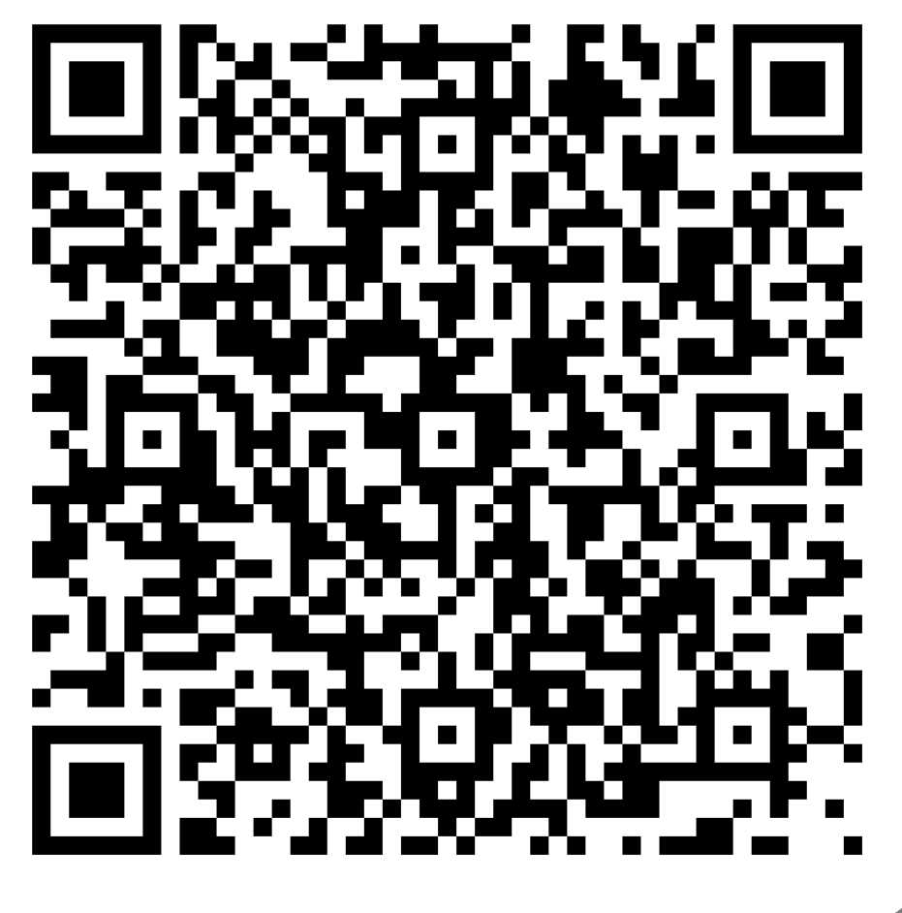
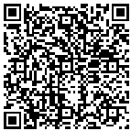
Questions and feedback
Submit your questions
https://forms.office.com/r/4B5hfiDFxZ
Event feedback form
https://s.zoom.us/m/bPFdIrVH7

