Slide 1
Q&A drop-in sessions
2026 Disability Research Funding

Slide 2
Acknowledgement of Country
The NDRP acknowledges the traditional custodians of Country throughout Australia. The peoples on whose land we live and work, have lived on and cared for Country for thousands of generations, and this land has never been ceded. We pay our respects to them and their cultures, and to Elders past and present.
Notes:
Slide 2
Title: Acknowledgement of Country
The NDRP acknowledges the traditional custodians of Country throughout Australia. The peoples on whose land we live and work, have lived on and cared for Country for thousands of generations, and this land has never been ceded. We pay our respects to them and their cultures, and to Elders past and present.

Slide 3
Agenda for this Q&A session
What NDRP is funding
Pre-submitted questions
Break
Open forum for questions
Reminders and next steps
Notes:
Slide 5
Title: Knowledge
evidence from academic and community-based research,
information, insights and story held by people and communities because of their lived, cultural, service and/or systems experience, and
expertise from practice.

Slide 4
2026 Disability Research Funding
Safety of people with disability
Research questions initiated by teams
Accessible and inclusive communities
Research questions initiated by teams
Duration of funding: 12 months
Duration of funding: 12 months
Up to $300,000 per team
Total $2.4 million
Up to $300,000 per team
Total $2 million
Safety of people with disability
Research projects focused on pathways to elimination of restrictive practices for people with disability
Duration of funding: 12 months
Up to $300,000 per team
Total $600,000

Slide 5
Research teams
Partner organisation(s)
Research Team Members
Contact Person
Administrating Organisation

Slide 6
Assessment criteria
1. Relevance to the topic and potential for policy and system impact (20% weighting)
2. Research quality and methodology (30% weighting)
3. Leadership and inclusion of people with disability (25% weighting)
4. Capacity and resources to deliver the project (15% weighting)
5. Risk management and value for money (10% weighting)

Slide 7

Break time
Time for a 10-minute break!
✔ Stretch
✔ Grab a drink
✔ Rest your eyes
We will start again soon.
Notes:
Slide 16
Break time
Time for a 10-minute break!
✔ Stretch
✔ Grab a drink
✔ Rest your eyes
We will start again soon.

Slide 8
Core information sources for 2026
NDRP Guiding Principles
2026 Frequently Asked Questions
NDRP resources and videos
Subscribe to the newsletter
Register for future sessions
APO Disability Research Collection
NDRP Funding Guidelines
NDRP Research Agenda
NDRP Research Funding Policy

Slide 9
New resources
Download Briefing note for Accessible and Inclusive Communities (Word).
Watch What do we mean by accessible and inclusive communities? (Video).
Watch What role do standards play in creating accessible and inclusive communities? (Video).
Watch Understanding policy, programs and impact in Australia: A guide for disability research (Video).
Watch How can research influence real change in policy and practice? (Video).

Slide 10
Timelines
Guidelines released
23 Feb 2026
Form opens
23 Feb 2026
Assess applications
Announce funding
Form closes
20 April 2026
5pm AEST
Projects start 1 July 2026
Projects finished by 30 June 2027
8 weeks
Up to 12 months
Q&A Drop in Sessions
Evidence to Action: Accessible and Inclusive Communities
Evidence to Action: Safety of People with Disability
23 March 2026 12:30–2:30pm AEDT
9 April 2026
12:30–2:30pm AEST
16 March 1pm AEDT
18 March 4pm AEDT
30 March 1pm AEDT
01 April 4pm AEDT

Slide 11
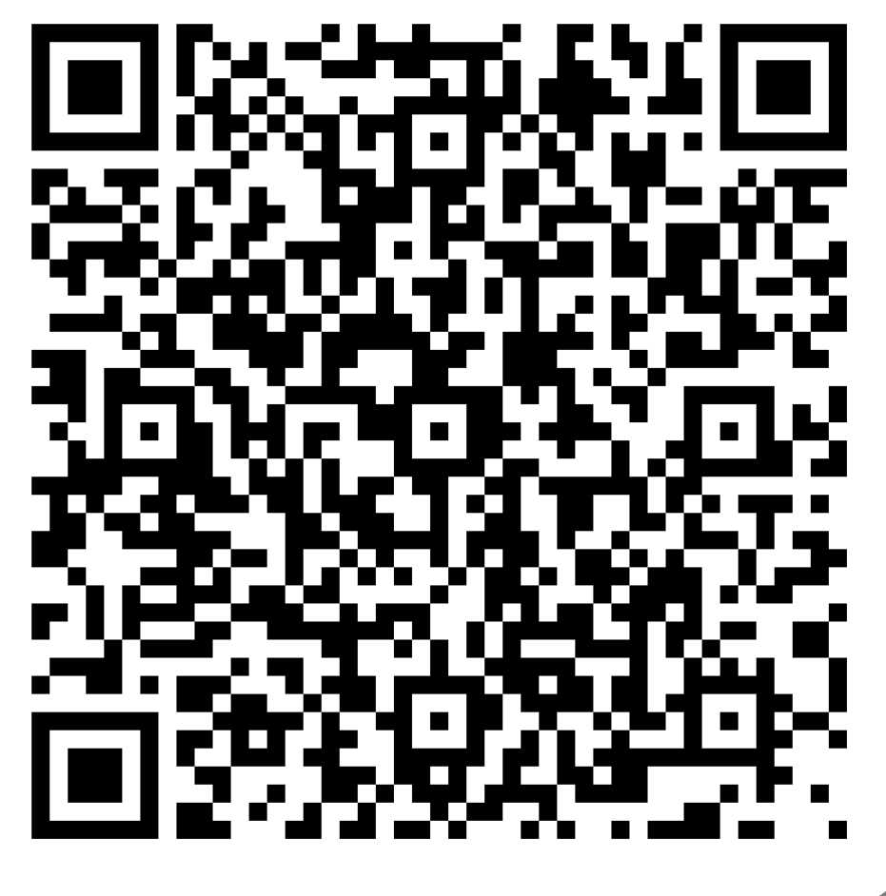
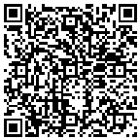
Questions and feedback
Submit your questions
https://forms.office.com/r/4B5hfiDFxZ
Event feedback form
https://s.zoom.us/m/bPFdIrVH7

Slide 12




How to engage with the NDRP
Email: info@ndrp.org.au
Phone: 03 9000 3813 SMS only number: 0485 931 168
Subscribe to our newsletter at www.ndrp.org.au for updates
Follow us on Facebook and LinkedIn
Notes:
Slide 12
Title: How to engage with the NDRP
Decorative icons and text reads:
Email: info@ndrp.org.au
Phone: 03 9000 3813
SMS only number: 0485 931 168
Subscribe to our newsletter at www.ndrp.org.au for updates
Follow us on Facebook and LinkedIn
END

